Slide 1
Practical Techniques for Planning Evaluations: The System Evaluation Protocol
William M. Trochim
Cornell University
Workshop
prepared for the
National Centre for External
Evaluation of Education (NCEEE)
May 23, 2019
Zagreb, Croatia

Slide 2
Goals of Workshop
Provide practical techniques for evaluation
Provide experience with key evaluation planning step
Integrate evolutionary systems evaluation approaches
Introduce the Systems Evaluation Protocol (SEP)
Introduce the Sep cyberinfrastructure – the Netway

Slide 3
What is the Systems Evaluation Protocol?
The Systems Evaluation Protocol (SEP) is a step-by-step guide for evaluation professionals who wish to integrate a evolutionary systems evaluation perspective into their work with organizations in order to enhance the quality and appropriateness of program evaluations.

Slide 4
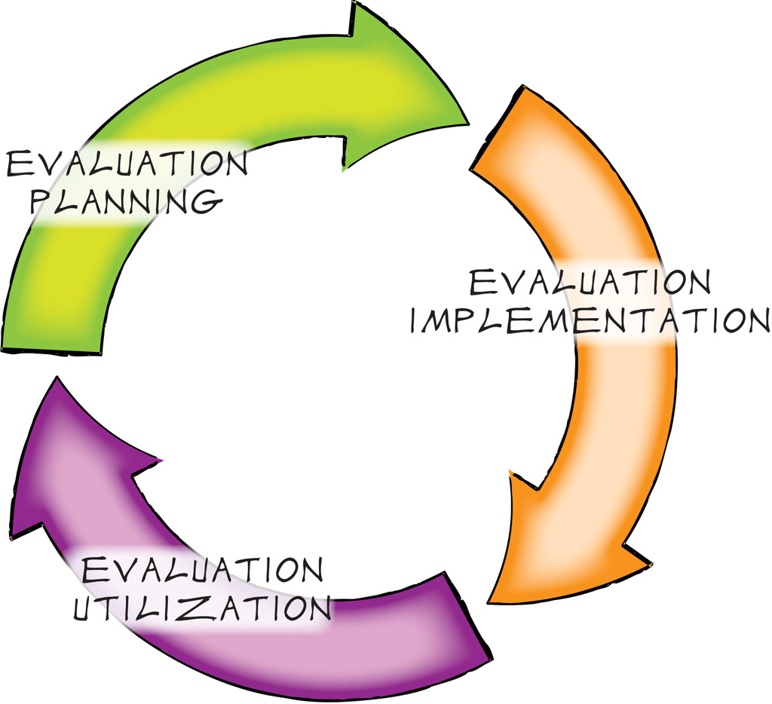
A Very Brief Introduction to the SEP

Slide 5
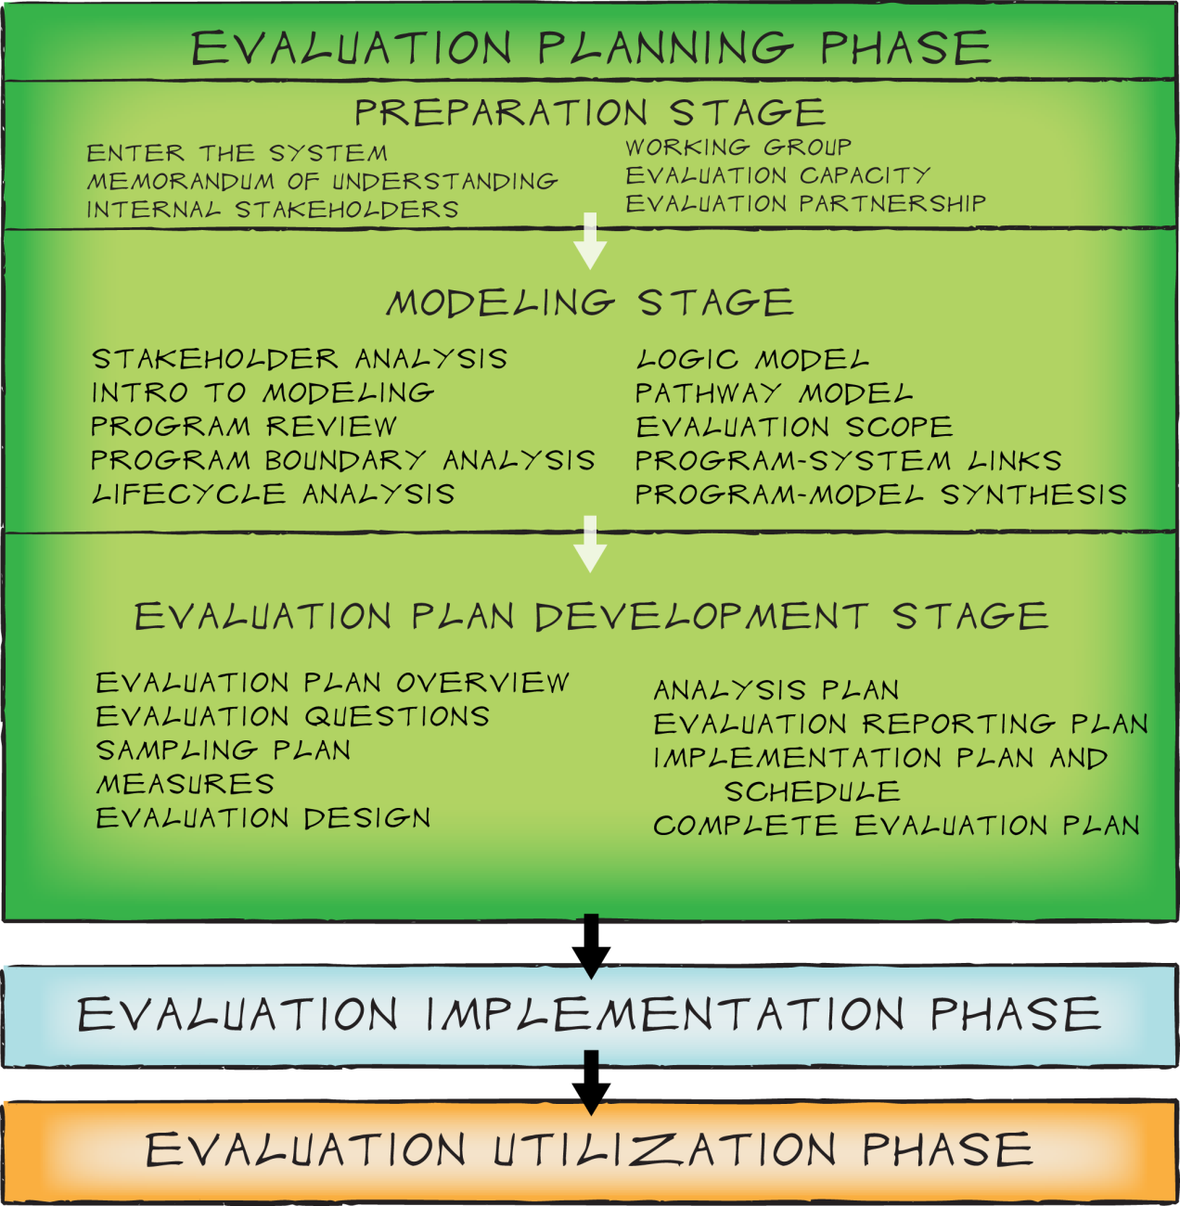
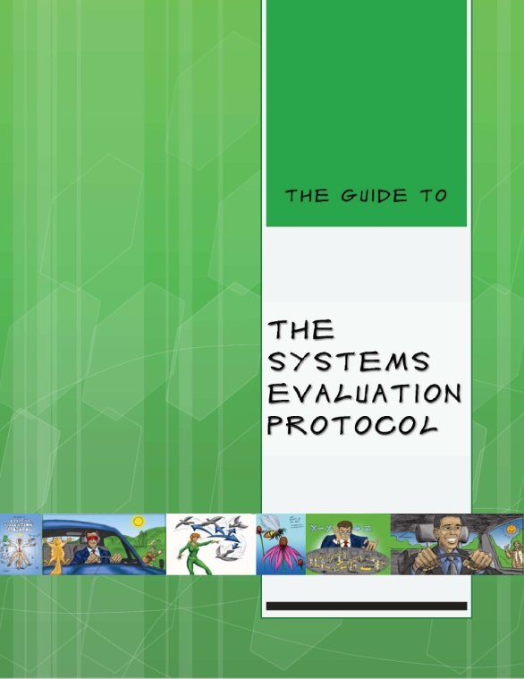
A Less Brief Introduction to the SEP
Focus for today – Modeling (“well begun is half done”)
https://core.human.cornell.edu/

Slide 6
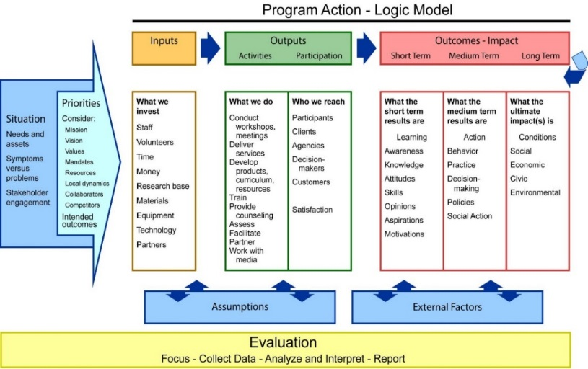
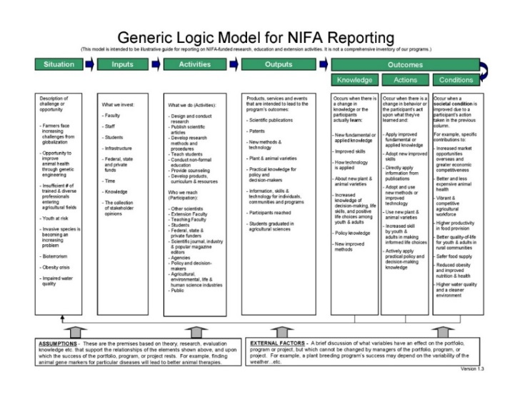
Common Logic Model Formats
Logic & Pathway Models

Slide 7
Logic Model
Logic & Pathway Models

Slide 8
Logic Model
Logic & Pathway Models

Slide 9
Causal Structures and Pathway Models
Logic & Pathway Models
What leads to what?

Slide 10
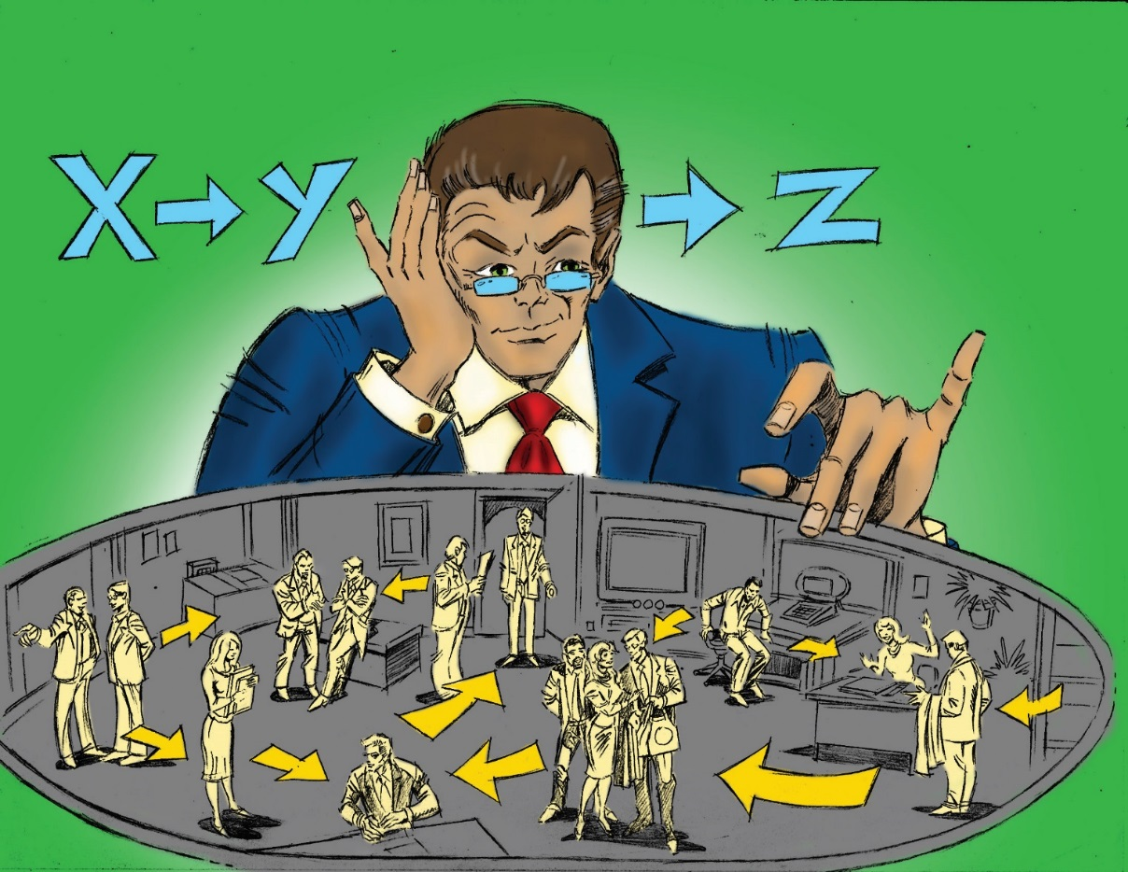
Causal Structures and Pathway Models
Logic & Pathway Models
What leads to what?
or
…and then,
and then,
and then…

Slide 11
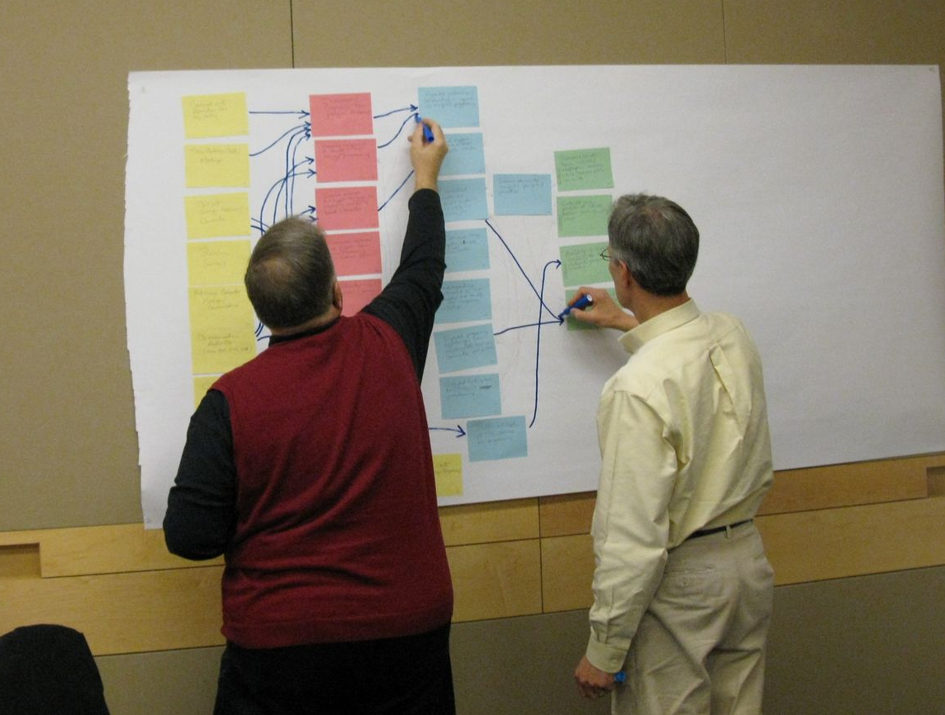
Logic & Pathway Models

Slide 12
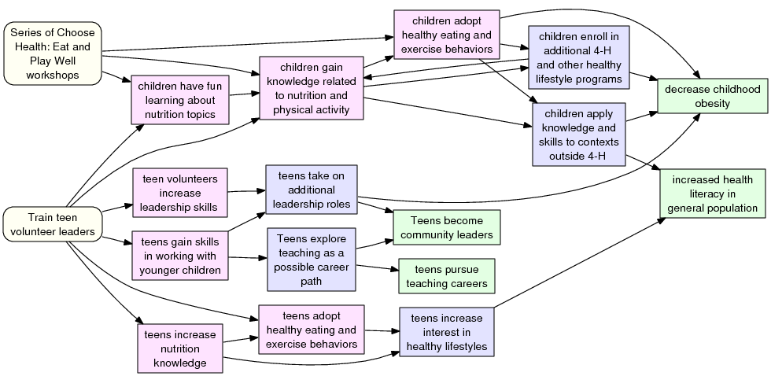
Pathway Model
Logic & Pathway Models
Activities
Short Term Outcomes
Mid Term Outcomes
Long-Term Outcomes
CCE Madison County: Choose Health Series
Pathway Model, May 2011
Notes:
Pathway model is a graphical version of a logic model, but conveys the program logic much more specifically. Visual tool is more appealing and (in practice) a more powerful tool for sharing perspectives, getting diverse stakeholders on the same page, etc.

Slide 13
Pathway Models
Logic & Pathway Models
Tell the story of how a project or program “works”
Present the project’s theory of change
Reveal complexity, interactions, and progression

Slide 14
How Logic Model and Pathway Model relate
Logic & Pathway Models
Logic Model
Pathway Model
Mission
Causality,
Program Theory
Description
Core Program Model elements:
Activities & Outcomes
Assumptions
Shows “sub-programs”
Context
Inputs
Tells “story” graphically
Outputs

Slide 15
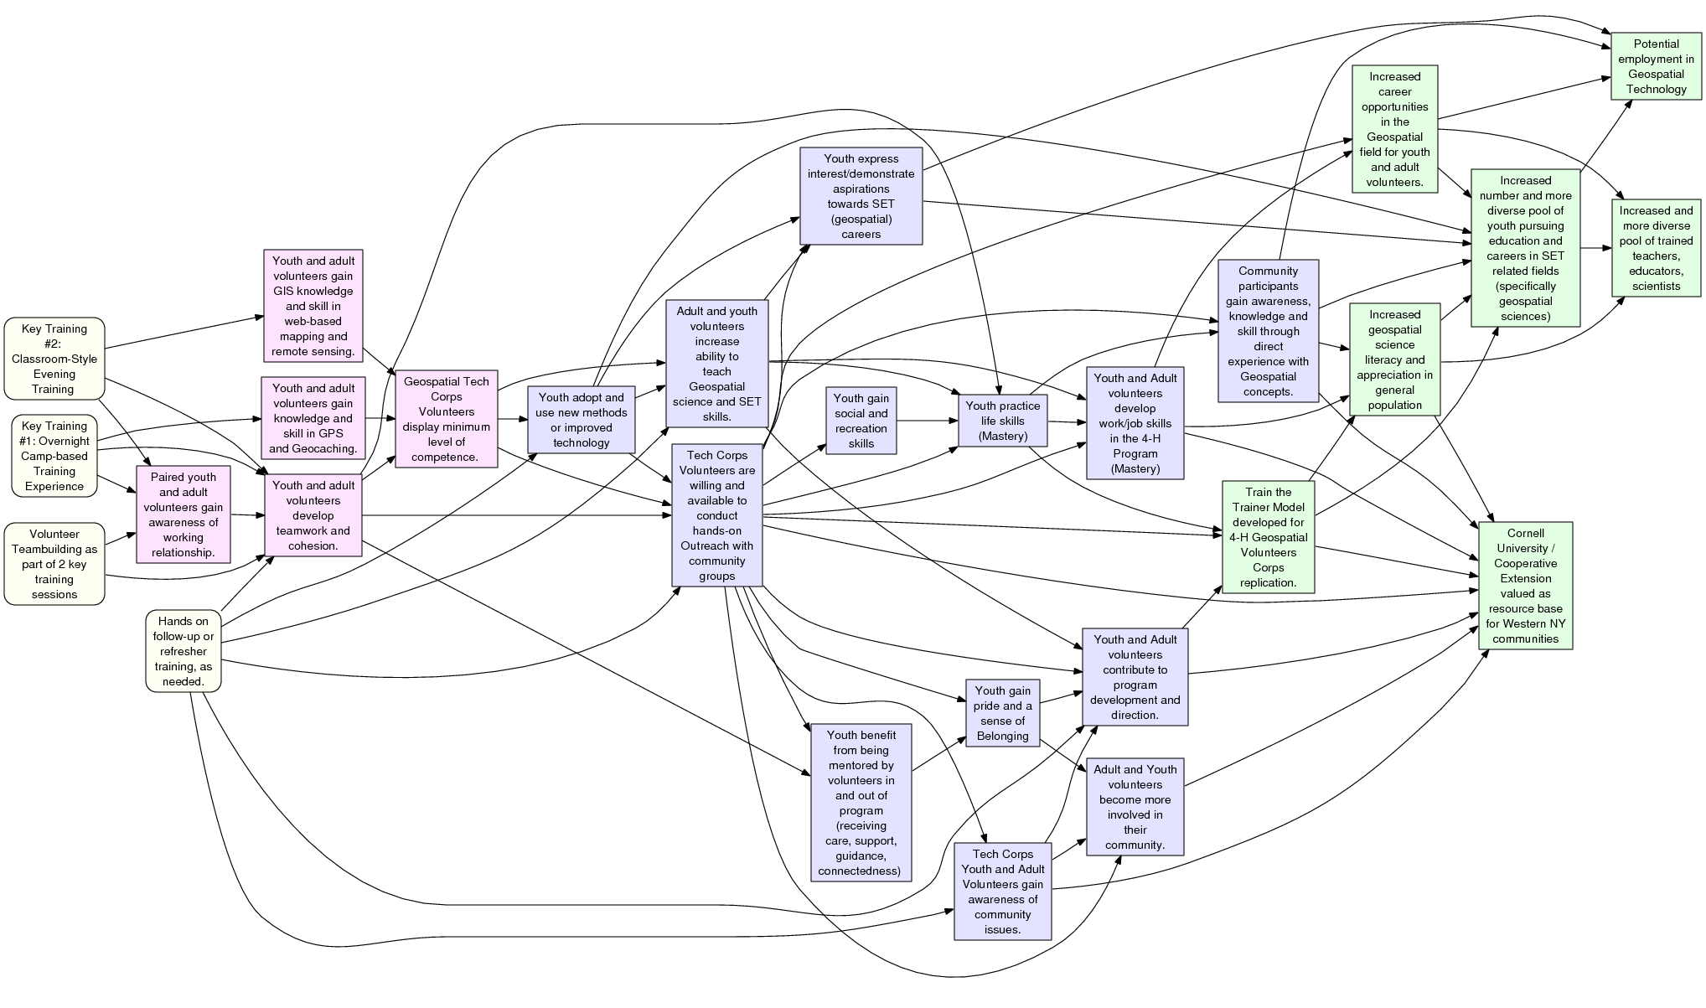
Simple Pathway Model
Logic & Pathway Models
Activities
Short Term Outcomes
Mid Term Outcomes
Long-Term Outcomes
CCE Genesee County: 4-H Geospatial Technology Corps Program
Pathway Model, May 2011

Slide 16
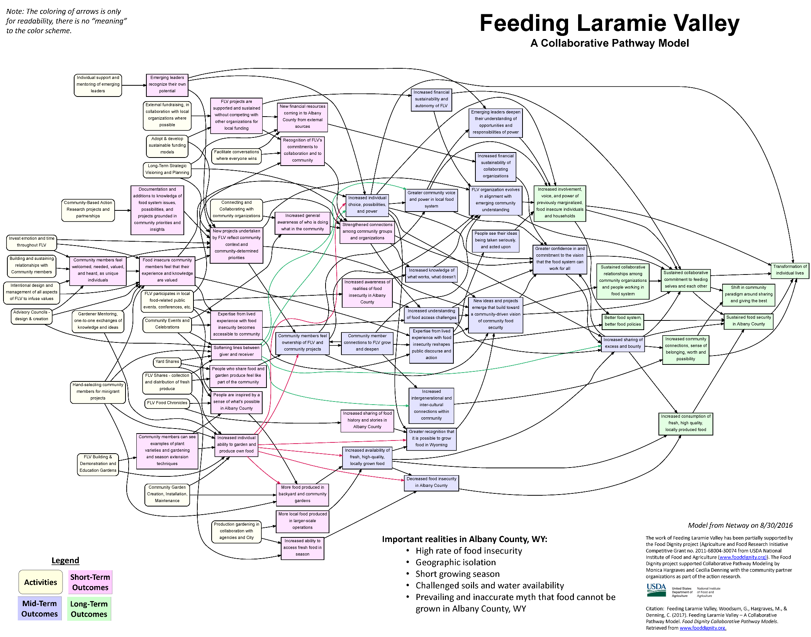
Complicated Pathway Model
Logic & Pathway Models
Notes:
Each model is unique!

Slide 17
Exercise: Developing a Pathway Model
Logic & Pathway Models
List long-term outcomes (2-3) on cards
List major activities (5-10) on cards
Arrange activities (on left) and long-term outcomes (on right)
Leave space between them for short- and mid-term outcomes
Determine a path from one or more activities to one long-term outcome
What are the steps? (And then, and then, and then…)
Record short and mid-term outcomes on cards
Draw arrows from card to card to describe pathway
Repeat step 4 several times

Slide 18
Logic & Pathway Models
Research: G&GE
Research: D&D
Resilient, sustainable, equitable, massively distributed smart grid
Research: I&I
???
Workforce Development
Inclusive culture of innovation and entrepreneurship in industries and universities
Diversity & Inclusion
Next generation of researchers, industry, and consumers ready to sustain and expand convergent approaches
Innovation Ecosystem
???
Stakeholder Engagement
???
Team Formation
???

Slide 19
Logic & Pathway Models
Research: G&GE
Outcome
Research: D&D
Outcome
Resilient, sustainable, equitable, massively distributed smart grid
Research: I&I
Outcome
Outcome
Outcome
???
Outcome
Workforce Development
Outcome
Outcome
Outcome
Inclusive culture of innovation and entrepreneurship in industries and universities
Outcome
Diversity & Inclusion
Outcome
Outcome
Outcome
Outcome
Next generation of researchers, industry, and consumers ready to sustain and expand convergent approaches
Innovation Ecosystem
Outcome
Outcome
???
Outcome
Outcome
Stakeholder Engagement
Outcome
???
Team Formation
Outcome
Outcome
???

Slide 20
Exercise: Developing a Pathway Model
Logic & Pathway Models
List long-term outcomes (2-3) on cards
List major activities (5-10) on cards
Arrange activities (on left) and long-term outcomes (on right)
Leave space between them for short- and mid-term outcomes
Determine a path from one or more activities to one long-term outcome
What are the steps? (And then, and then, and then…)
Record short and mid-term outcomes on cards
Draw arrows from card to card to describe pathway
Repeat step 4 several times

Slide 22
Using Pathway Models in Evaluation
Logic & Pathway Models
Identifying Stakeholder Priorities
Developing Evaluation Questions
Setting Evaluation Scope
Identifying Program and Evaluation Lifecycles
Linking Research Literature
Identifying and Developing Measures

Slide 23
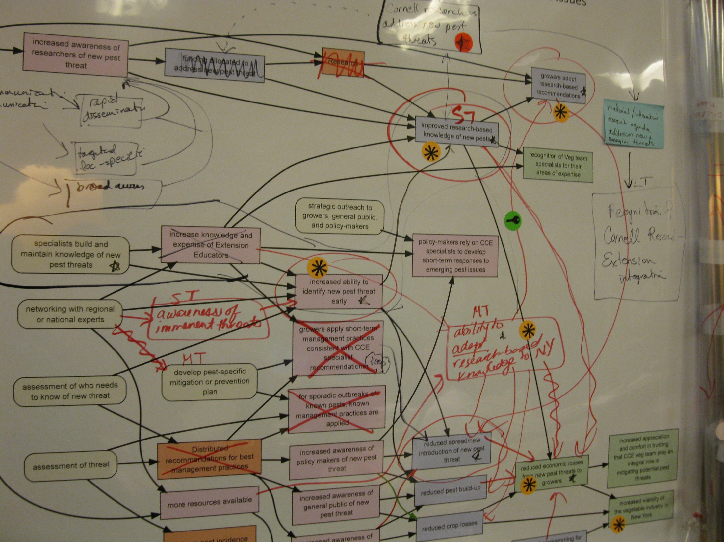
“Mining the Model”
“Mining” the Model
Notes:
The thinking and development stage can be complicated. But in fact it is in the shared building of the model, and then iterations of commentary and feedback, that many of the gains are achieved – this is where people manage to get on the same page in terms of their understanding of what their program is about.

Slide 24
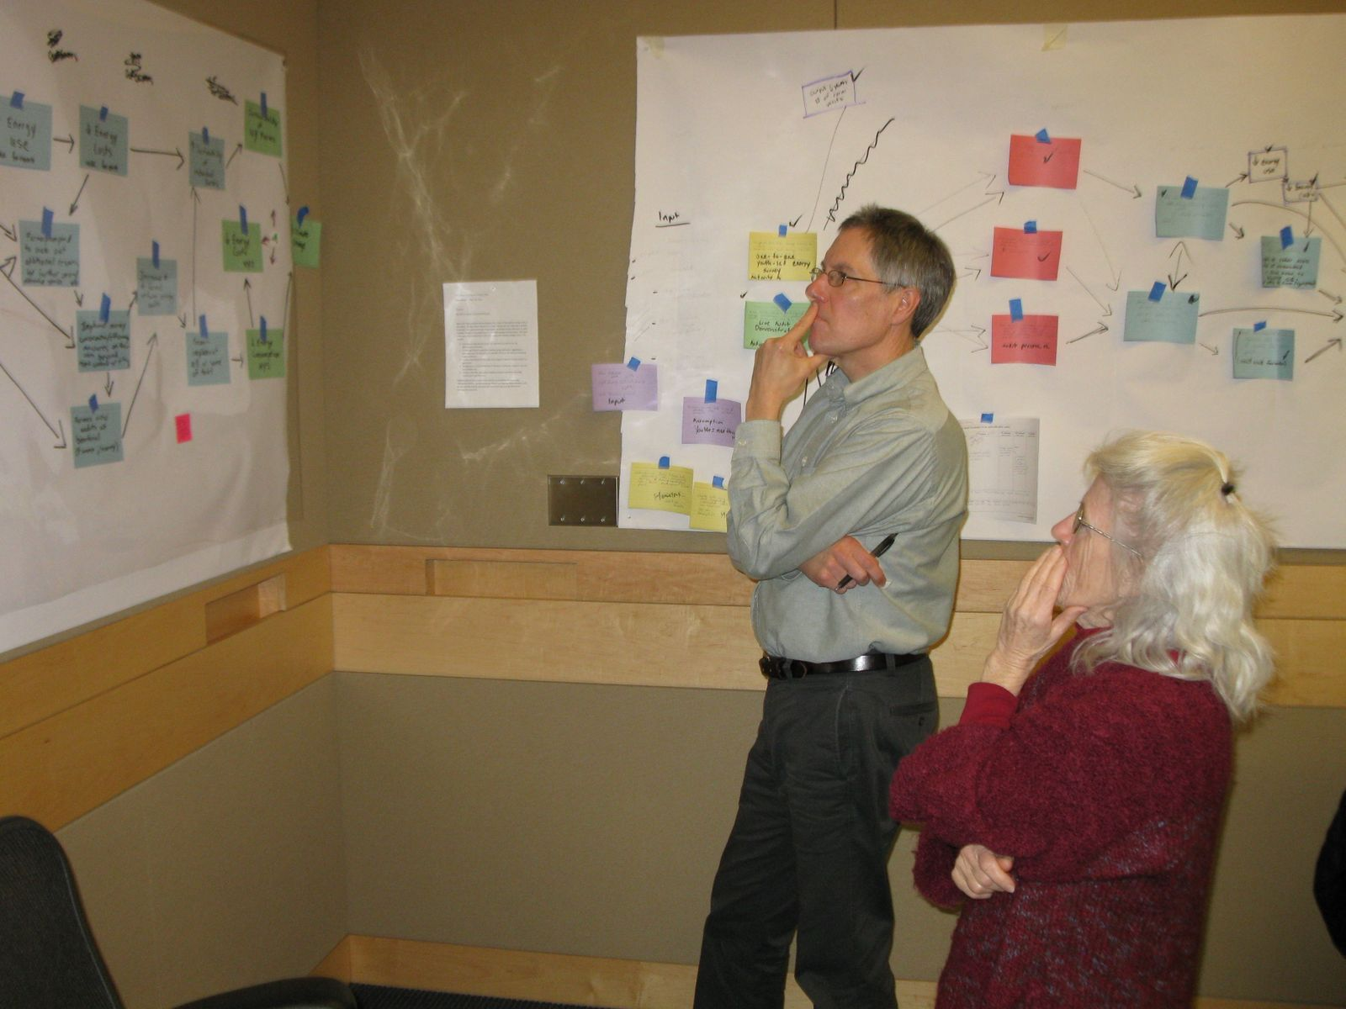
“Mining the Model”
“Mining” the Model

Slide 25
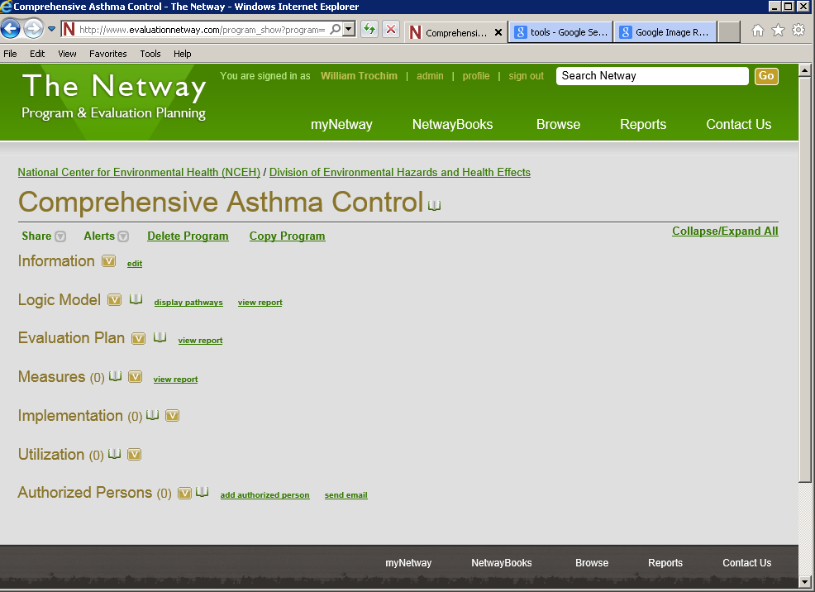
The Netway
The Netway
Web-based software developed by CORE
Facilitates program modeling and evaluation planning
Increases shared knowledge and identifies connections among programs
Notes:
Netway is a key tool for developing Logic Model, Pathway Model, Evaluation Plans
And sharing ideas, learning from others, identifying shared outcomes (because you can see and search everything in the Netway, even though you can only create and edit your own, plus there are built-in mechanisms for keeping track of outcomes that are common to multiple programs.)

Slide 26
NETworked PathWAY Models (Netway)
The Netway

Slide 27
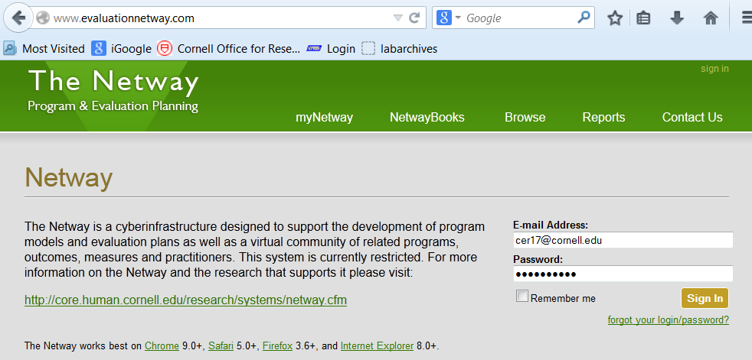
The Netway
The Netway
http://www.evaluationnetway.com

Slide 28
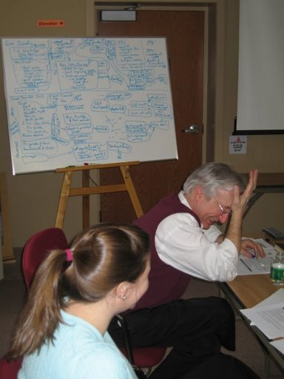
So Where Does This Leave Us?

Slide 29
Next Steps
Skim the SEP manuals
Sign up for the Netway
Get oriented to Netway interface
Identify a specific program you want to work on
Begin working through the SEP steps on the Netway

Slide 30
For further information
William Trochim
Cornell University
wmt1@cornell.edu
https://core.human.cornell.edu/

